Slide 1
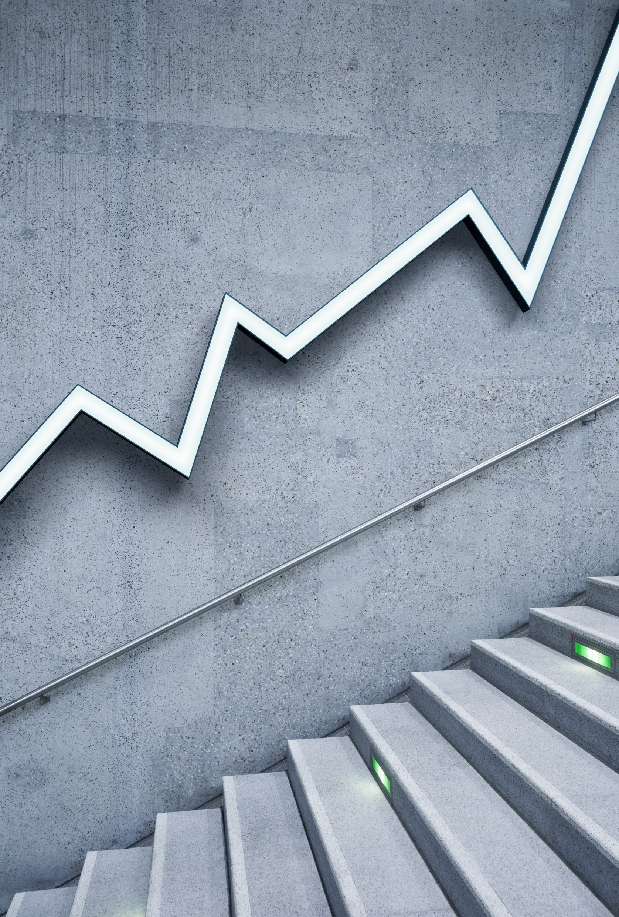
Understanding Supervised and Unsupervised Learning
Presented by: [Your Name]
Organization: Wadhwani Foundation / WGDT
A Simple Overview
Presented by: MD Shahil Organization: -Wadhwani Foundation / WGDT

Slide 2
Topics Covered in This Session
The Role of Technology in Today’s Era
Introduction to Machine Learning
What is Machine Learning?
Why Do We Need Machine Learning?
How Does Machine Learning Work?
Types of Machine Learning
Where Do Supervised and Unsupervised Learning Fit In?
Supervised vs. Unsupervised Learning

Slide 3

Today’s Technology Era
Rapid digital transformation is reshaping industries.
AI and ML are transforming industries
AI and automation are driving efficiency and decision-making.
Data-driven technologies enhance productivity and policy-making.
Machine Learning (ML) is at the core of these advancements.
Example:-
Predicting crop diseases
Grouping farmers based on behavior
Detecting unusual patterns in farming data
Traffic Alerts (Online challan)

Slide 4
Applications
We Use
Traffic Alerts
Social Media
Transportation and Commuting
Products Recommendations
Virtual Personal Assistants
Self Driving Cars
Dynamic Pricing
Google Translate
Online Video Streaming
Fraud Detection

Slide 5
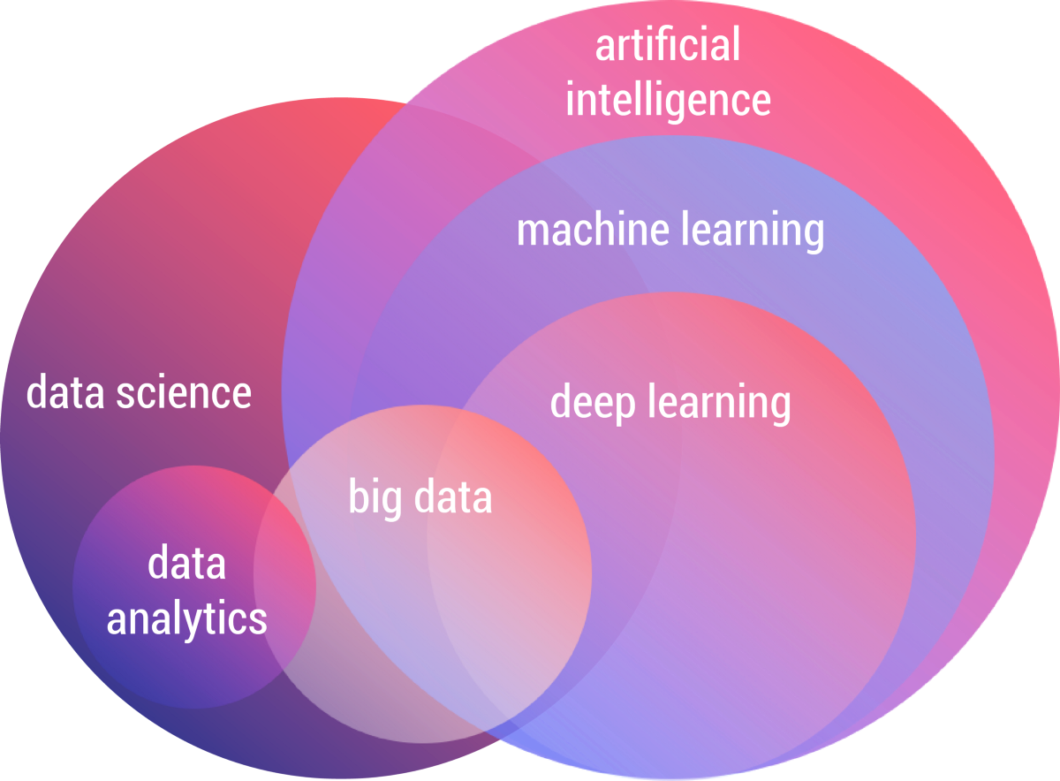
Today’s Technology Era Based on AI
And Machine Learing is Core/Base of Artificial Intelligence

Slide 6
Introduction to Machine Learning
What is Machine Learning?
ML is a branch of AI that enables computers to learn from data without explicit programming.
It helps in predicting outcomes, recognizing patterns, and automating processes.
This makes them more similar to humans.
The ML models continuously learns and improves its performance with data.
Key Takeaways:
ML is like teaching computers to make decisions based on data.
Example: A system that predicts weather patterns based on past climate data.

Slide 7
Data
ML Algorithm
ML Model
ML Algorithm are Mathametical equations.(eg:- y=mx+c)
A model is the relationship between features and the label.

Slide 8
Why We Teach Machines to Find Patterns?
Automates complex decision-making processes.
Enhances efficiency and accuracy in data-driven policies.
Reduces human errors and improves predictions.
Leads to personalized solutions for various sectors.
Why Machine Learning is Needed?
The amount of data generated is too large for manual processing.
ML improves efficiency, accuracy, and automation.
Real-world impact: Agriculture, healthcare, finance, and governance.
Enables data-driven decision-making for better policies.

Slide 9
Now, you have a clear understanding of these key questions:
What is Machine Learning?
Why We Teach Machines to Find Patterns?
Why Machine Learning is Needed?
BUT
We Now Machine Learning Learns From Data
then what we do if data are diffrent types!

Slide 10
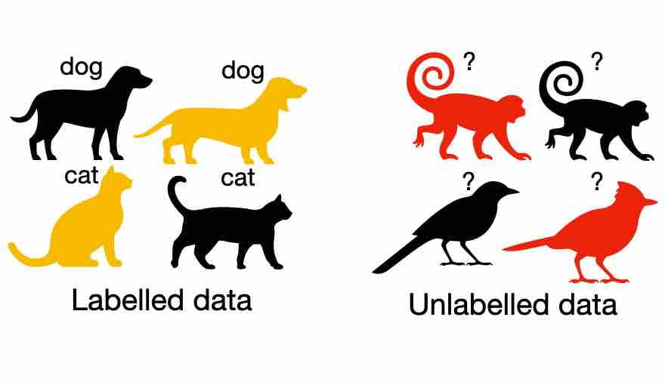
In ML we divide data into 2 Parts
1. Label data
2. Unlabel data

Slide 11
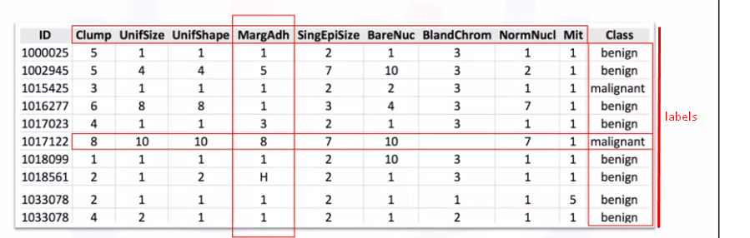
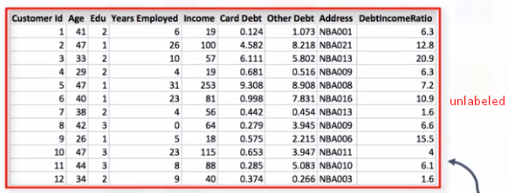

Slide 12
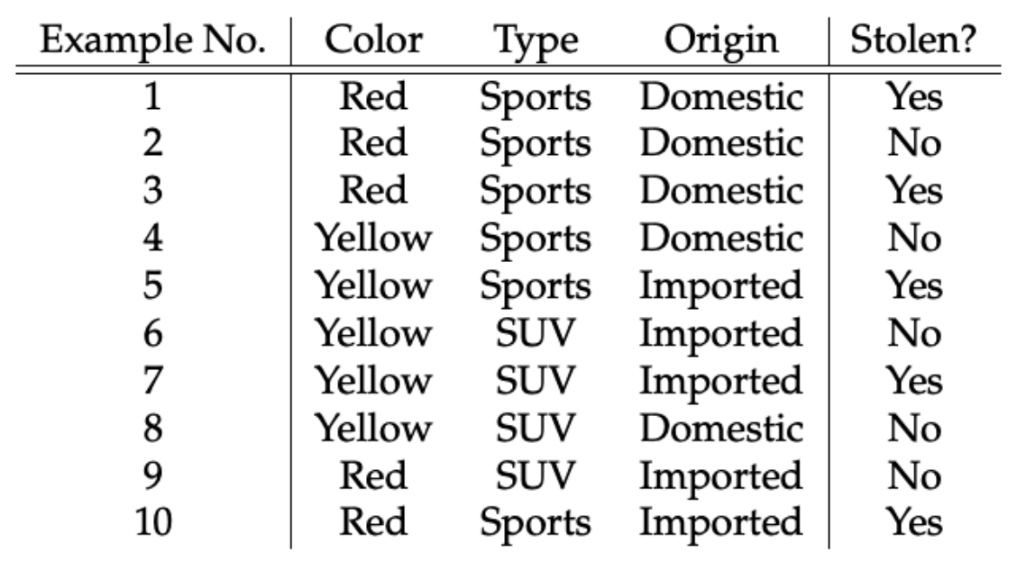
Tabular data to predict whether car is stolen or not?
Features
Label

Slide 13
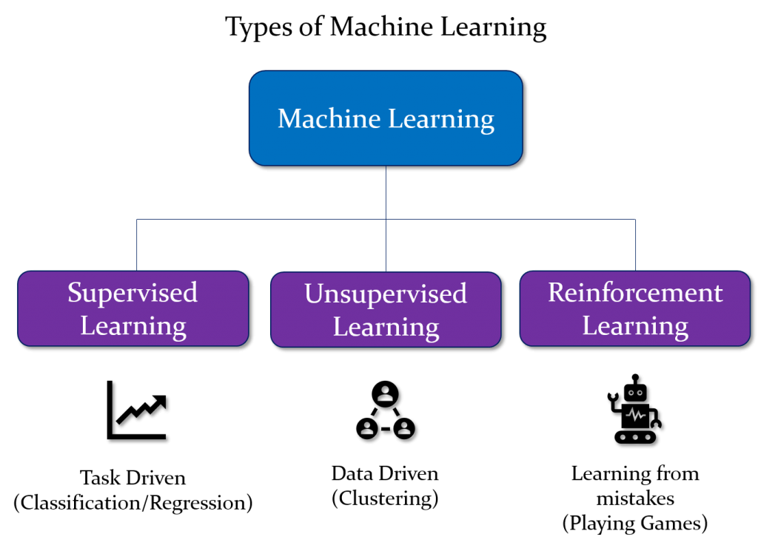
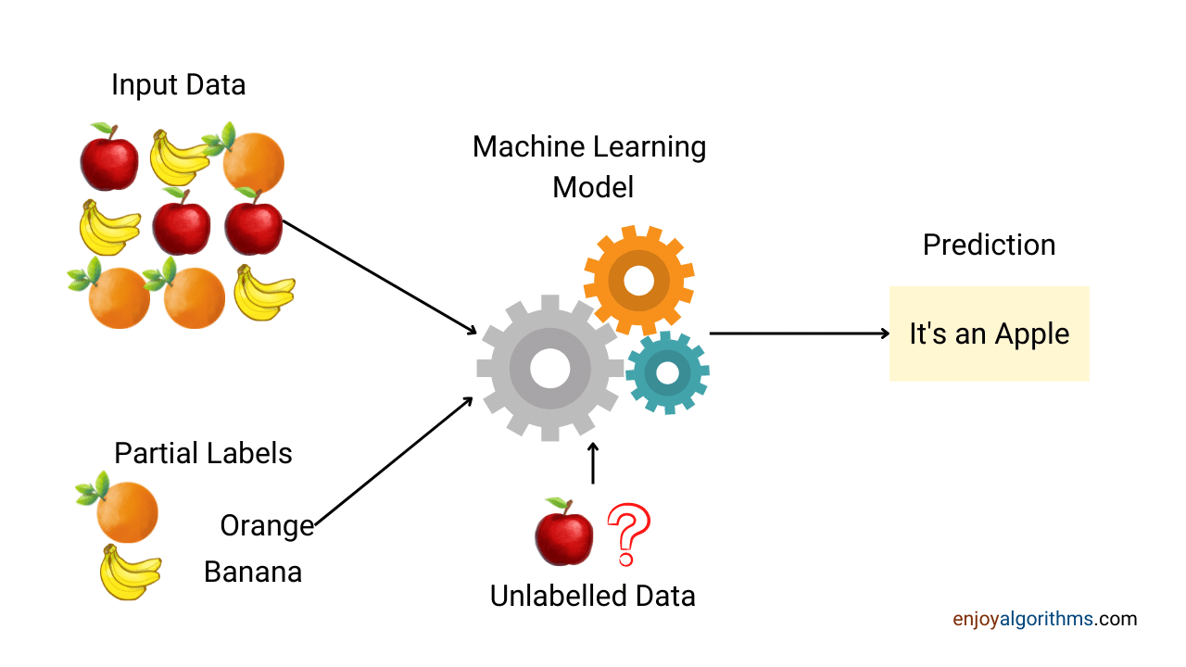
Based on data We Divide ML in Different Types
Semi-Supervised
Learning

Slide 14
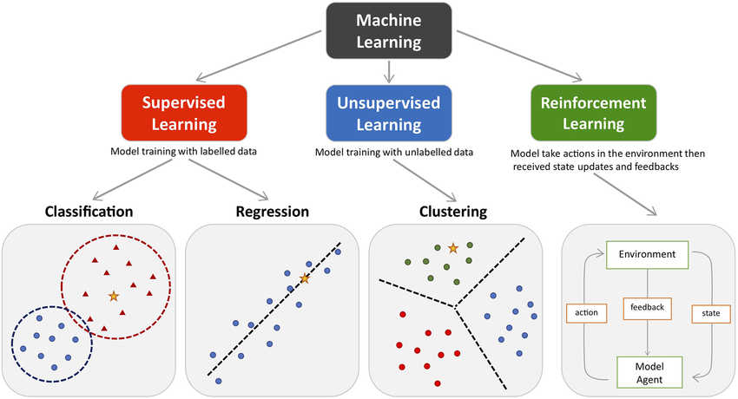

Slide 15
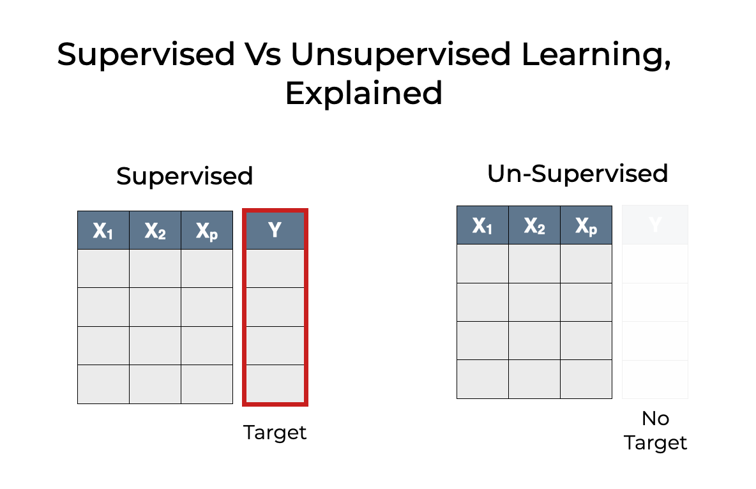

Slide 16
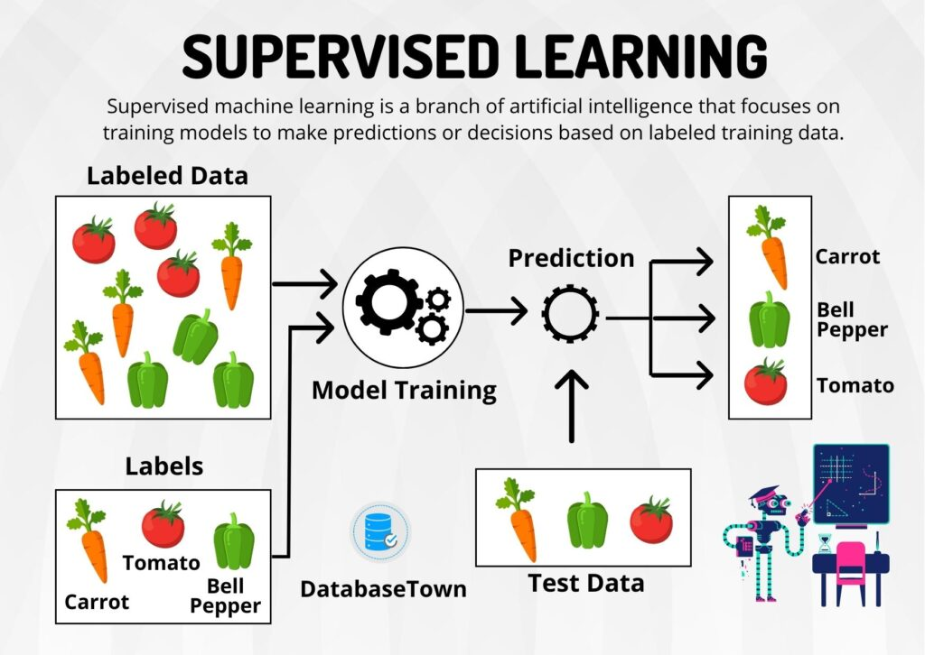

Slide 17
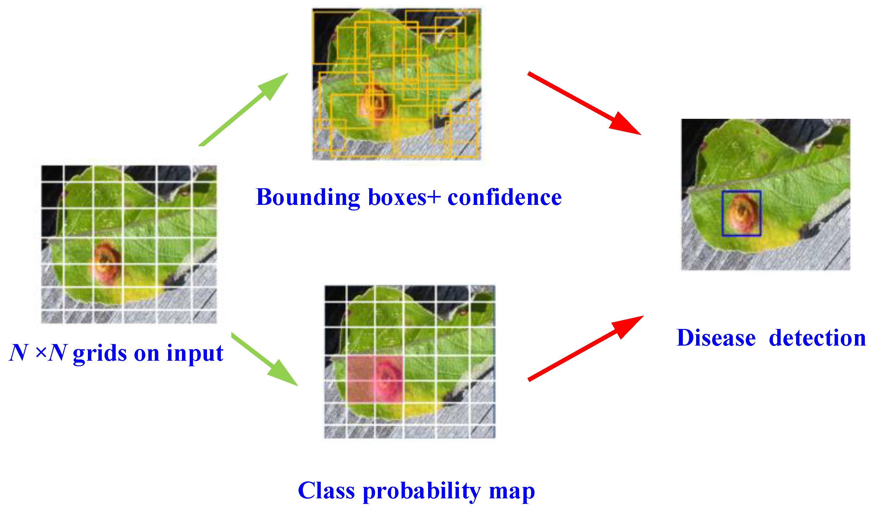
In supervised learning, we teach the machine using data that includes both inputs (features) and correct outputs (labels).
The goal is to make predictions for new, unseen data based on the learning.
Example in Agriculture:
Crop Disease Detection: Train the model with images of healthy vs. diseased crops, then predict whether a new crop is diseased or healthy.
Example – Predicting Crop Yield
Scenario: You have data from past years: weather, soil quality, water availability, etc.
The system learns from this data (input-output relationships) to predict how much yield a crop will produce in future seasons.
Key Outcome: Predict crop yield based on historical data.
Visual: Show a graph with weather and soil data vs. crop yield.

Slide 18
Supervised
In Supervised learning, you train the machine using data which is well "labeled."
It means data is already tagged with the correct answer.
Training a Machine (model) on labeled data (known input-output pairs) to make predictions.
Supervised Learning uses labeled data to train models.
Senerio: If we provide a model with past crop yield data along with weather conditions, it can predict future yields.
Examples:
1. Crop Yield Prediction - Predicting future crop yield based on past data.
2. Pest Detection - Identifying crop diseases using images.
3. Weather Forecasting - Using past climate data to predict upcoming conditions.

Slide 19
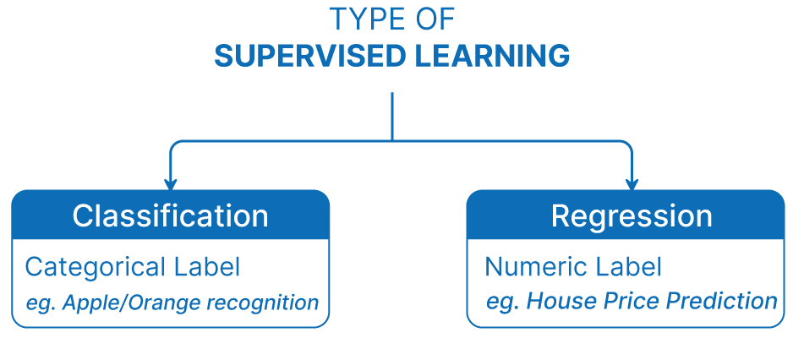
Based on Label data We Divide Supervised Learning into 2 Parts

Slide 20


Slide 21
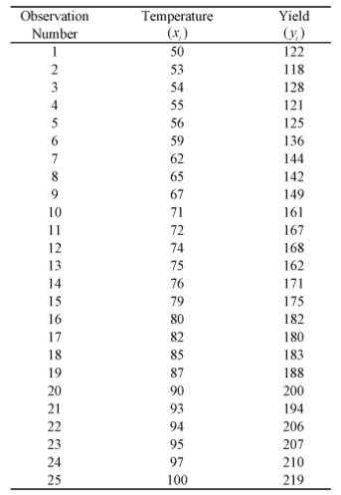
Here Based on temprature find Yied value

Slide 22
Supervised Learning in Agriculture
1. Crop Yield Prediction - Predicting future crop yield based on past data.
2. Pest Detection - Identifying crop diseases using images.
3. Weather Forecasting - Using past climate data to predict upcoming conditions.

Slide 23
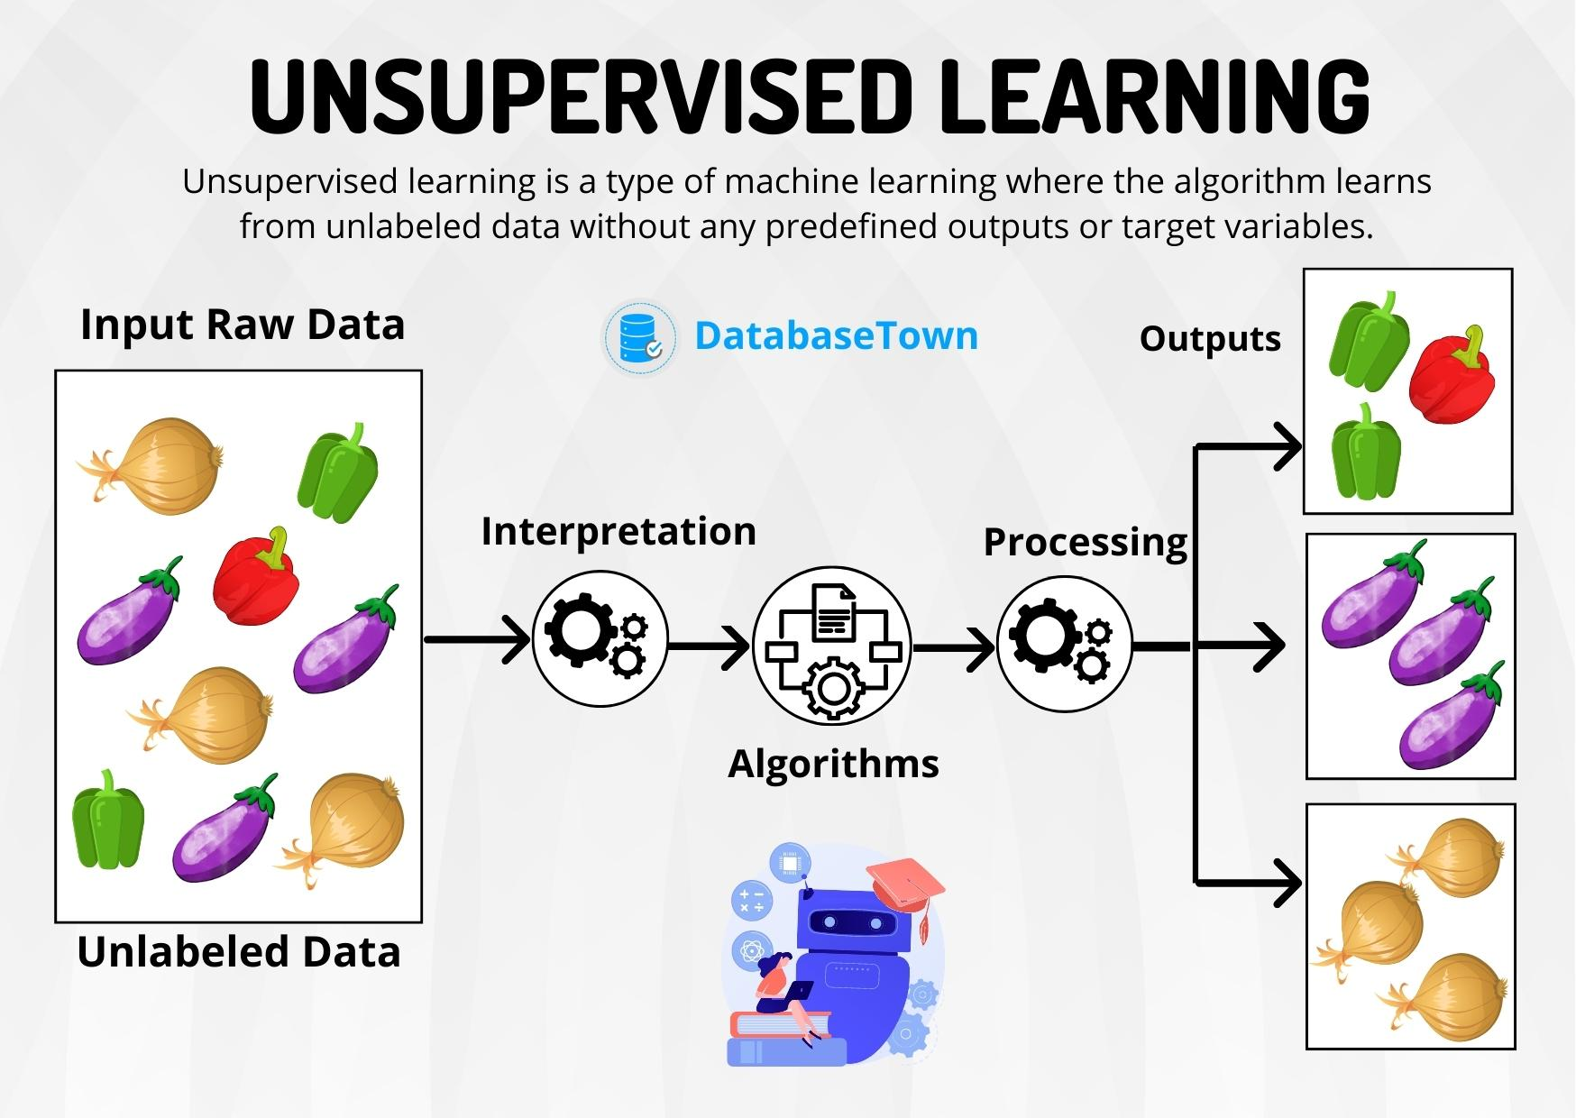

Slide 24
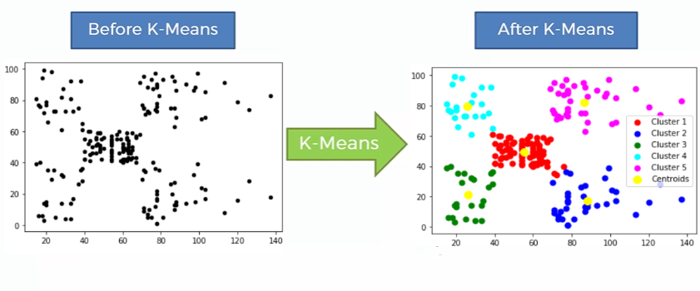
Unsupervised
Unsupervised Learning is a machine learning technique in which the users do not need to supervise the model.
Unsupervised learning looks for patterns in data without labels or outcomes.
It identifies structures like groups, trends, or relationships hidden within the data.
Example:
1. Grouping different types of soil based on characteristics.
2. Farmer Segmentation - Grouping farmers based on land size, crop type, or soil quality.
3. Market Price Anomaly Detection - Detecting unusual price changes in commodities.
4. Soil Type Classification - Identifying soil characteristics for better crop selection.

Slide 25
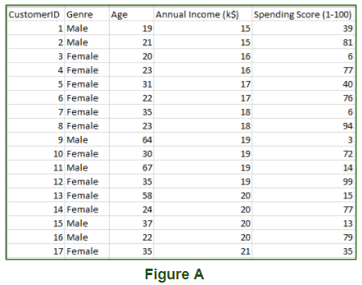
Example
A is Mall data that contains information about its clients that subscribe to them. Once subscribed they are provided a membership card and the mall has complete information about the customer and his/her every purchase.
Now using this data and unsupervised learning techniques, the mall can easily group clients based on the parameters we are feeding in.

Slide 26
Unsupervised Learning in Agriculture
1. Farmer Segmentation - Grouping farmers based on land size, crop type, or soil quality.
2. Market Price Anomaly Detection - Detecting unusual price changes in commodities.
3. Soil Type Classification - Identifying soil characteristics for better crop selection.

Slide 27
Example 2. – Grouping Farmers by Needs
Scenario:
Analyzing purchasing behavior of farmers in different regions (data like types of seeds, tools, and fertilizers bought).
The machine groups similar farmers together, helping create region-specific policies.
Key Outcome: Create more targeted policies for different farmer segments.

Slide 28
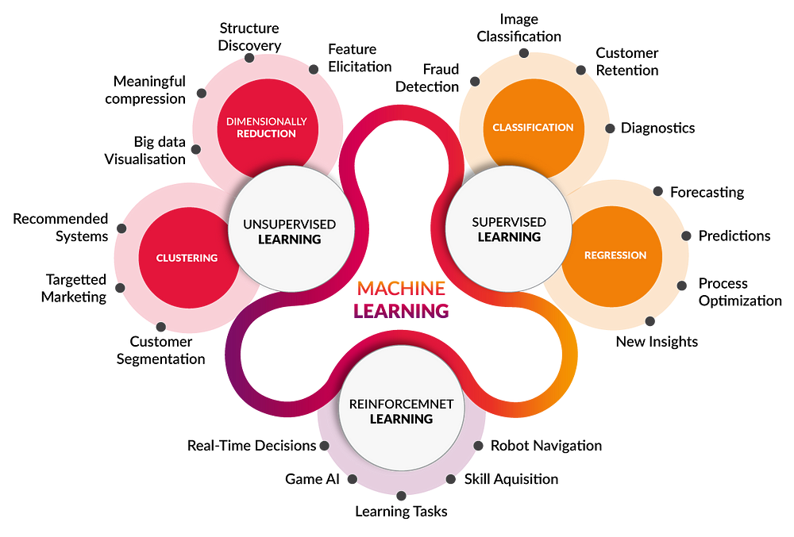
Examples use case

Slide 29
Based On | Supervised machine learning | Unsupervised machine learning
Input Data | Algorithms are trained using labeled data. | Algorithms are used against data which is not labelled
Computational Complexity | Supervised learning is a simpler method. | Unsupervised learning is computationally complex
Accuracy | Highly accurate and trustworthy method. | Less accurate and trustworthy method.

Slide 30
The goal of machine learning is to develop methods that can automatically detect patterns in data, and then to use the uncovered patterns to predict future data or other outcomes of interest.
-- Kevin P. Murphy

Slide 31
Key Differences Between Supervised and Unsupervised Learning
Supervised Learning | Unsupervised Learning
Requires labeled data (input-output pairs) | Uses only input data (no labeled outcomes)
Makes predictions based on past data | Finds patterns or groups in the data
Example: Crop Disease Detection | Example: Grouping Farmers for Policy Targeting

Slide 32
Conclusion
• Supervised Learning helps in predictions based on past data.
• Unsupervised Learning finds hidden patterns in large datasets.
• Both methods can help policymakers make informed decisions in agriculture.

Slide 33
QUESTIONS?

Slide 34
THANK YOU

